Slide 1
Electrification and switching to net-zero emission resources
Dr. Hua Wang
National Center of Technology Innovation for Green and Low-Carbon Building, China

Slide 2
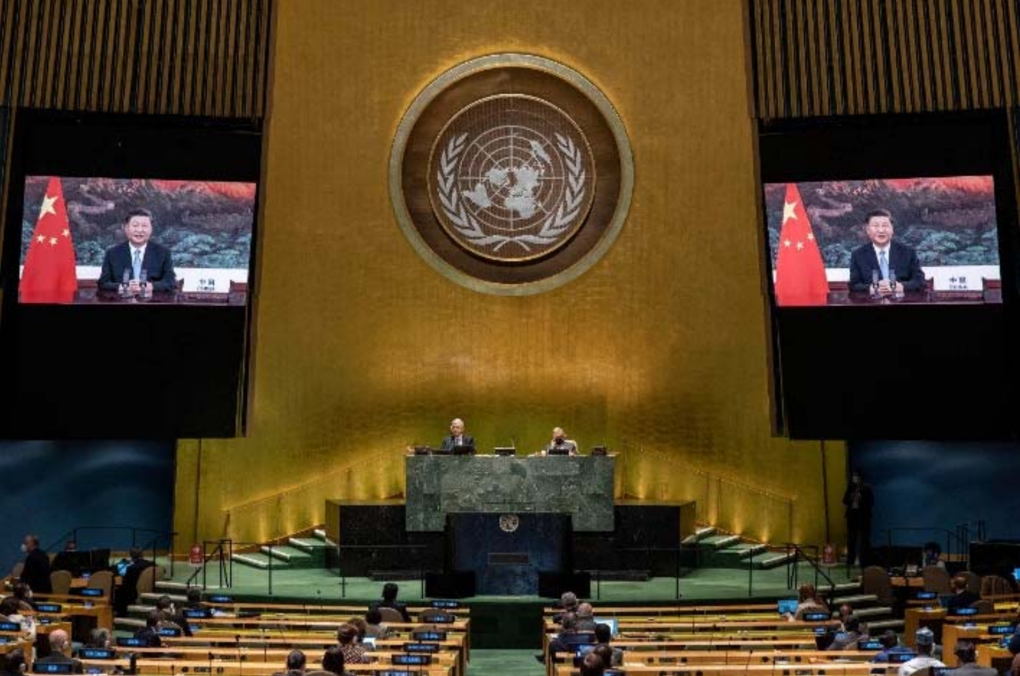
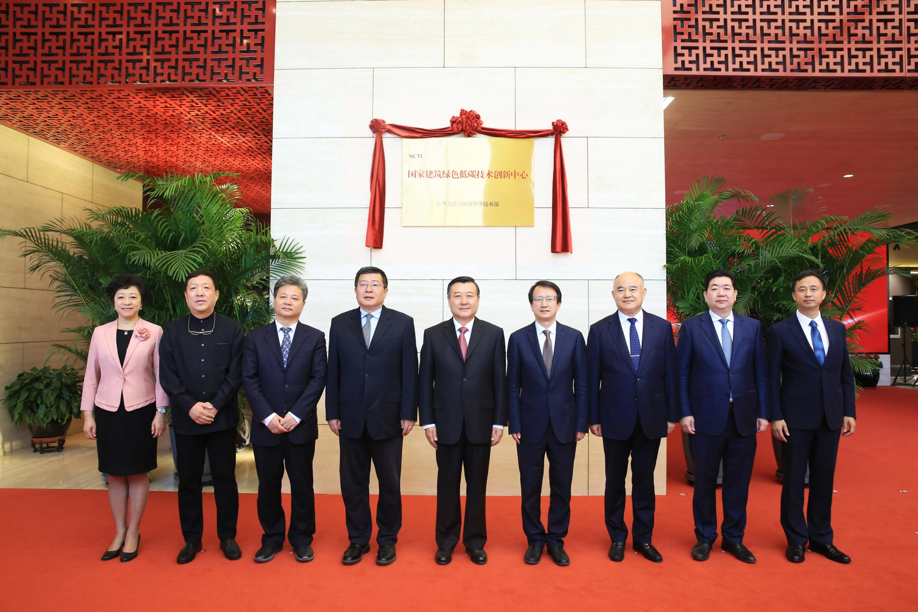
Who are we
On 22nd September 2020, “dual carbon” commitment was made by China at the 75th session of the United Nations General Assembly that China would peak carbon emissions by 2030 and achieve carbon neutrality by 2060
Sector-level action
NCTI-GB was set up to implement the “dual carbon” commitment in the buildings sector
On 9th May 2023, the inauguration ceremony of China’s National Center of Technology Innovation for Green and Low-Carbon Building (NCTI-GB) was held in Beijing, leaders from the Ministry of Housing and Urban-Rural Development, Ministry of Science and Technology, the State-owned Assets Supervision and Administration Commission of the State Council and the Beijing Municipal Government attended the ceremony

Slide 3
Contents
01
Introduction
02
Buildings and urban systems electrification in China
03
Switching to net-zero emission resources in China
04
Prospects

Slide 4
Part 01
Introduction

Slide 5
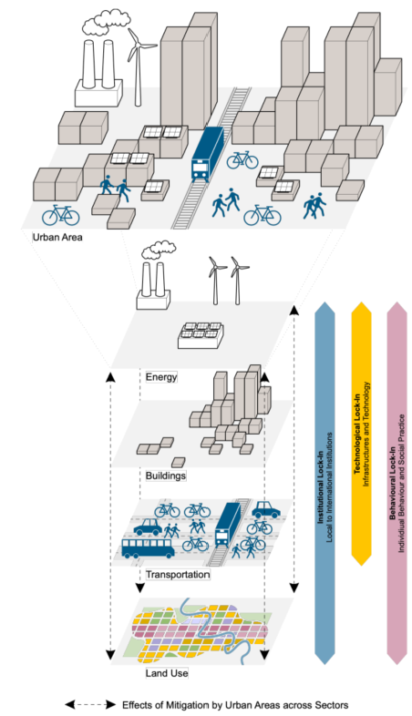
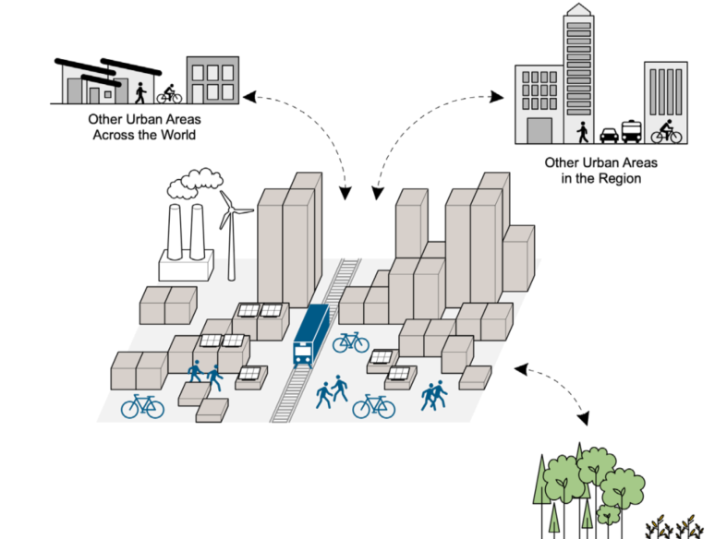
Cities are systems of interconnected sectors, activities and governance structures
Climate change mitigation measure 1: Electrification of energy end uses in cities and efficient energy demand for heating, transport and cooking through multiple options and urban infrastructure (Estimated mitigation potential: at least 6.9 GtCO2-eq by 2030 and 15.3 GtCO2-eq by 2050）
Source：IPCC_AR6_WGIII_Chapter08
Notes:
Urban-scale mitigation action can have cascading effects across multiple sectors of energy, buildings, transportation, and land use, as well as regional, national, and global impacts through supply chains, resource flows, and institution

Slide 6
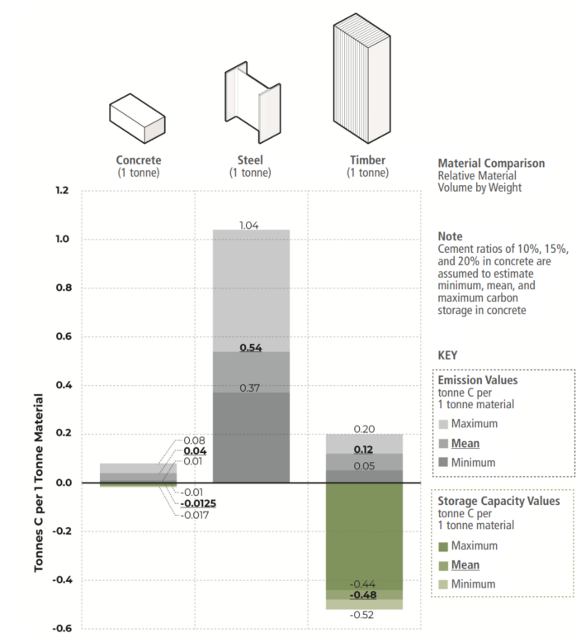
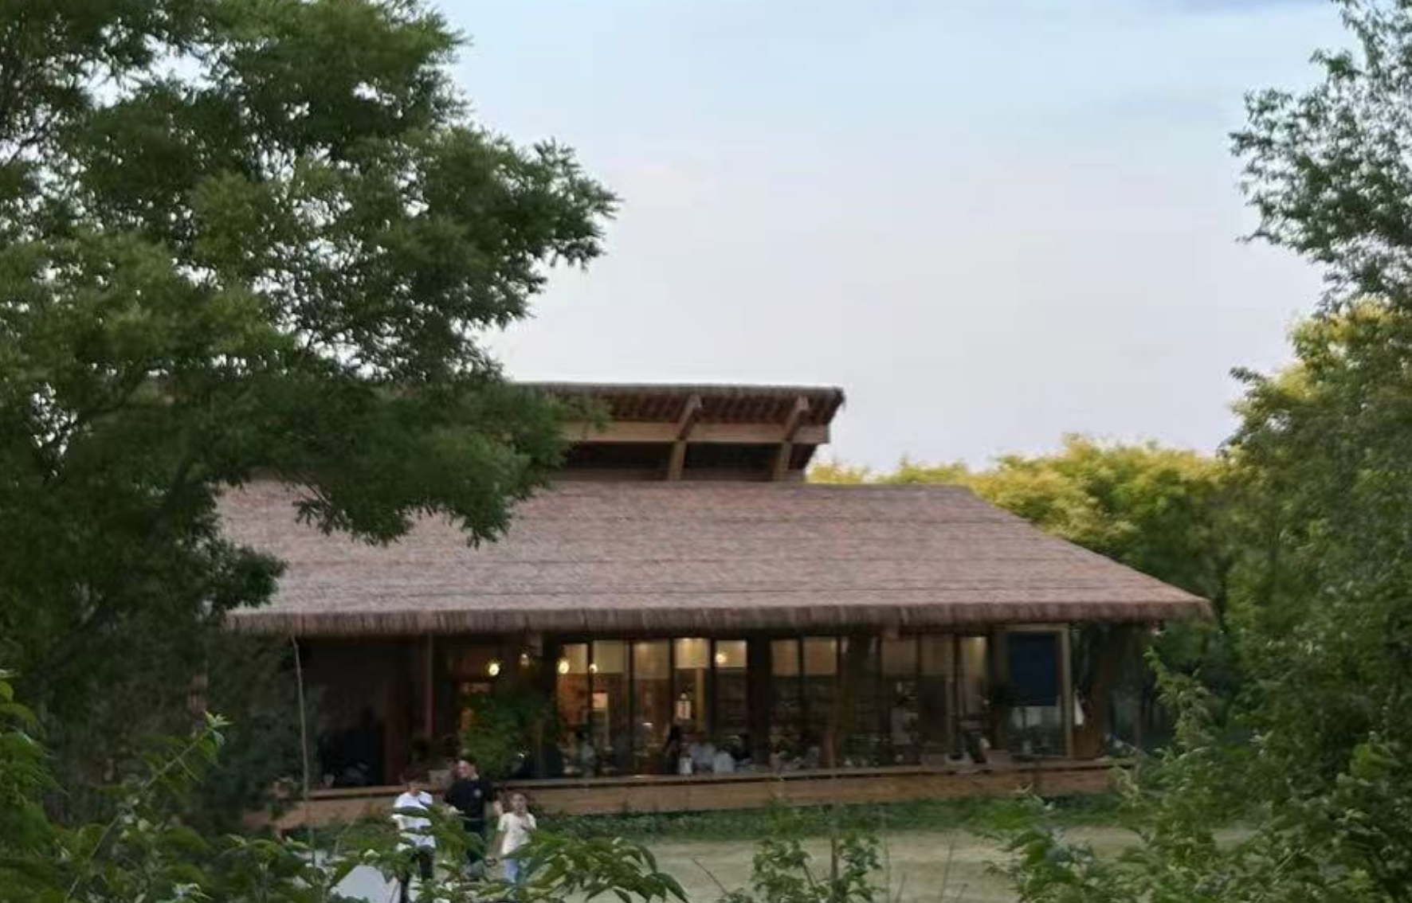
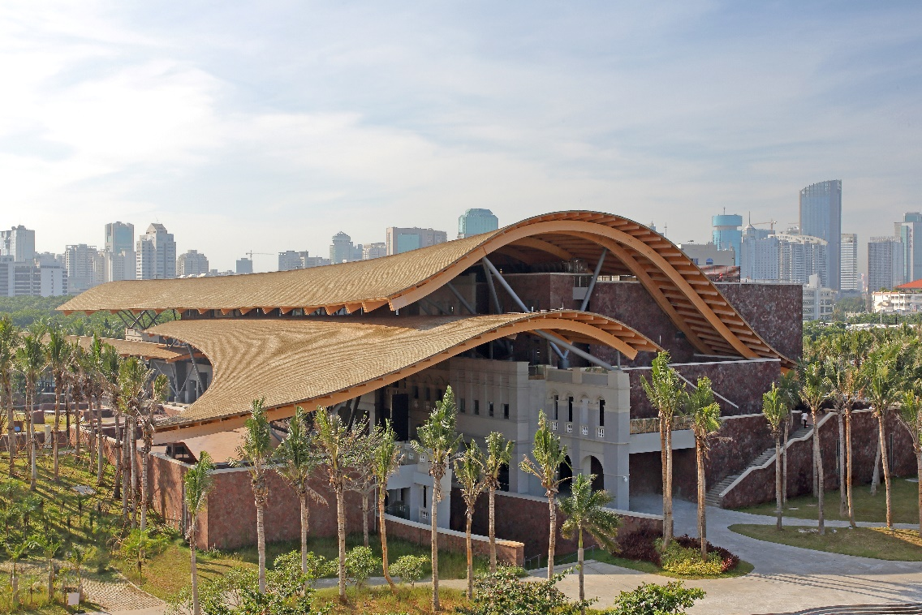
For the carbon embodied in supply chains to become net-zero, all key infrastructure and provisioning systems will need to be decarbonized, including electricity, mobility, food, water supply and construction
Climate change mitigation measure 2: Switching to net-zero materials and supply chains, with new and emerging structural assemblies in engineered timber offering the benefit of storing significant quantities of atmospheric carbon
Source：IPCC_AR6_WGIII_Chapter08
Photo courtesy of China Construction Technology Consulting Corporation
Notes:
Concrete and steel have substantial embodied carbon emissions with minimal carbon storage capacities, while timber stores a considerable quantity of carbon with a relatively small ratio of carbon emissions-to-material volume

Slide 7
Part 02
Buildings and urban systems electrification in China

Slide 8
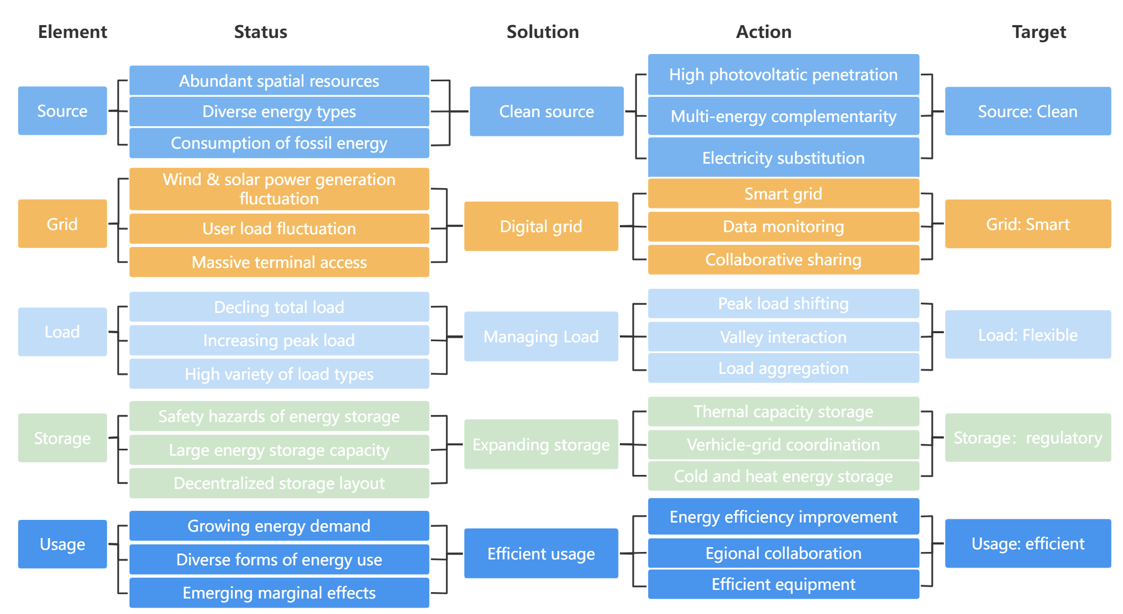
NCTI-GB’s technology framework for electrification
With energy transformation, buildings not only use energy, but also interact with power generation, power grid, power load and energy storage
Technology framework of urban system electrification includes five solutions – clean source, digital grid, load management, expanded storage and efficient usage
Source：National Center of Technology Innovation for Green and Low-Carbon Building, China
Notes:
单击此处添加文本

Slide 9
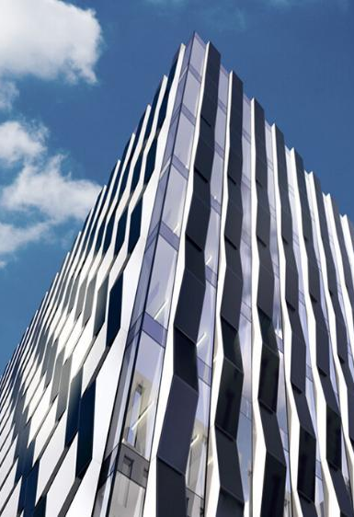

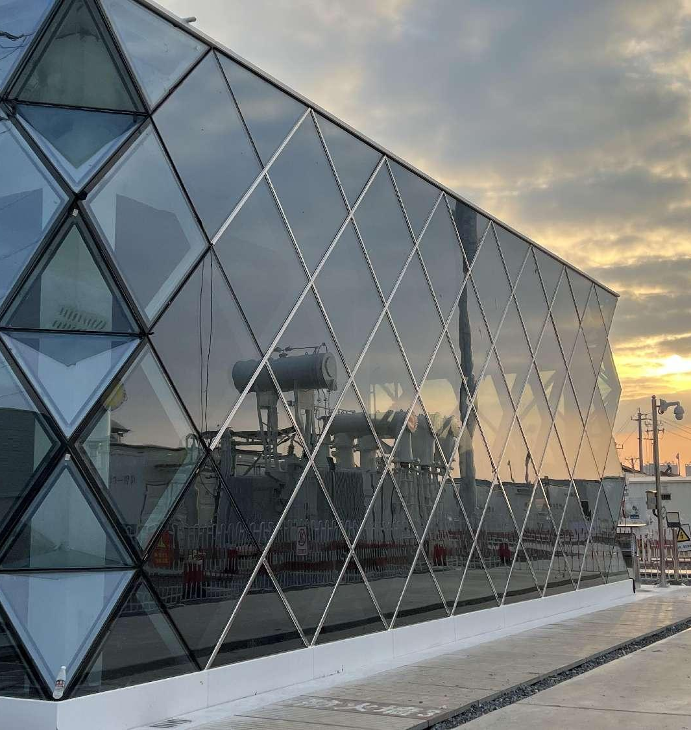
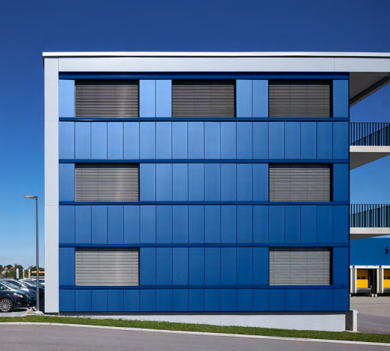

Urban system electrification solution: Clean source
What is the solution?
CdTe power glass BIPV, Germany
BIPV/BAPV
Distributed new energy aggregation technology
Energy complementary and collaborative technology with solar photovoltaic consumption as the core at multiple spatial scales such as urban areas, blocks, and communities
…
Cases：Worldwide BIPV solutions provided by China
BIPV curtain wall, Hubei, China
Volg Logistics Distribution Center, Switzerland
Photo courtesy of China Building Materials Group
Notes:
copper indium gallium selenide

Slide 10
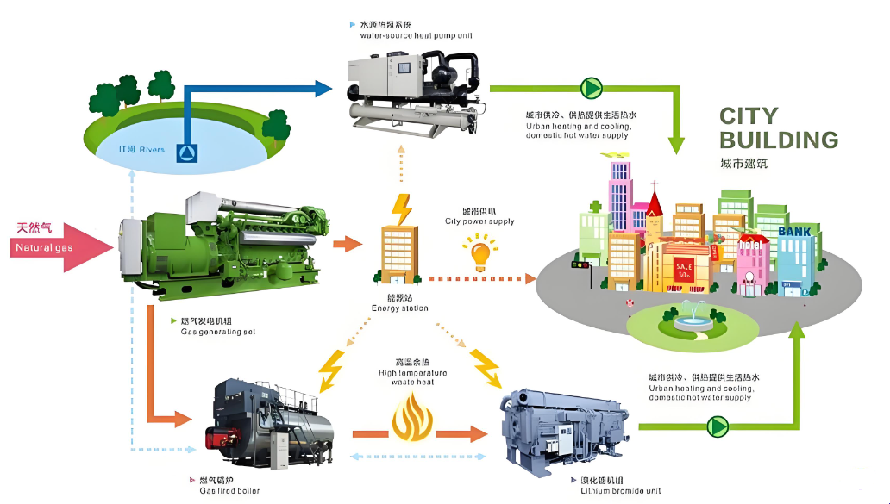
Barriers and challenges for electrification
How to establish a systematic way of thinking, expanding the energy-saving view of buildings to the whole chain of "source, grid, load, storage and use” of electrification
How to transform the traditional understanding of single buildings and expand scenarios to parks, urban areas and cities
How to channel investments and improve technology transfer to make electricity more affordable, stable, and clean for households in developing countries
Research findings from the National Center of Technology Innovation for Green and Low-Carbon Building, China
Photo courtesy of State Grid Corporation of China
Notes:
单击此处添加文本

Slide 11
Part 03
Switching to net-zero emission resources in China

Slide 12
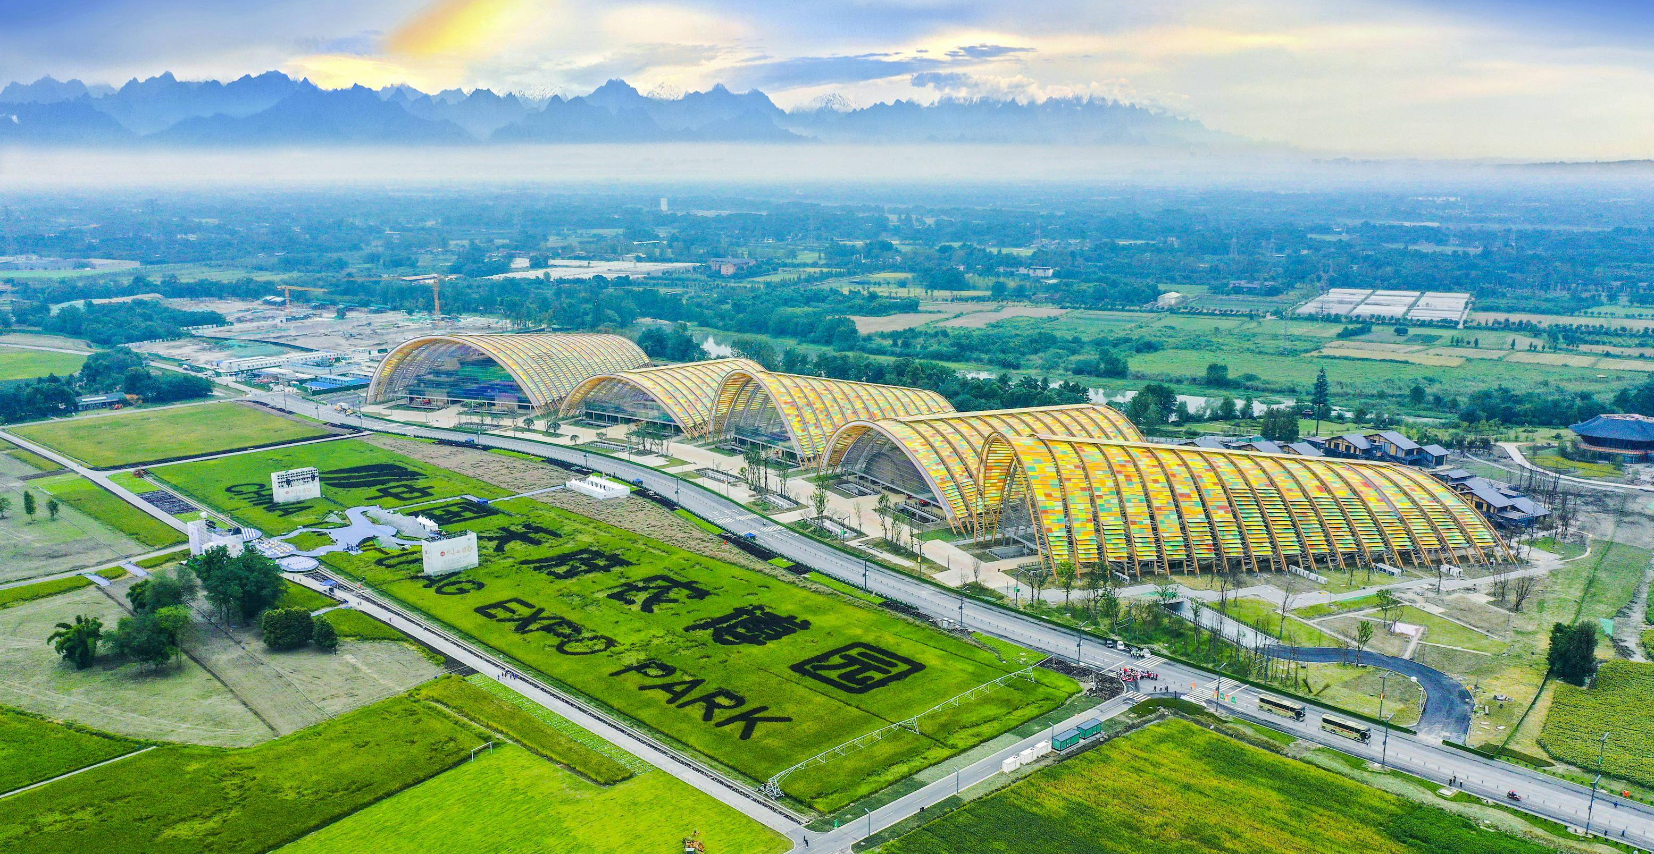
Practices of timber buildings in China
Sichuan Agricultural Expo Permanent Venue
Approved as a "National Rural Industry Integration Development Demonstration Park" and a "UIA 2030 Sustainable Development Goals Guide Case"
Structural System: Steel-wood hybrid structure
Type: Large public building
Location: Chengdu, China
Building Area: 132,000 m²
Features: The main exhibition hall project adopts a world-first steel-wood hybrid hollow truss arch, consisting of CNC-processed wooden purlins and an ETFE membrane structure system. The assembly of the steel-wood structure uses variable cross-section glued laminated timber as the upper and lower chord rods of the arched truss and tapered web members to form a triangular cross-section arched truss

Slide 13
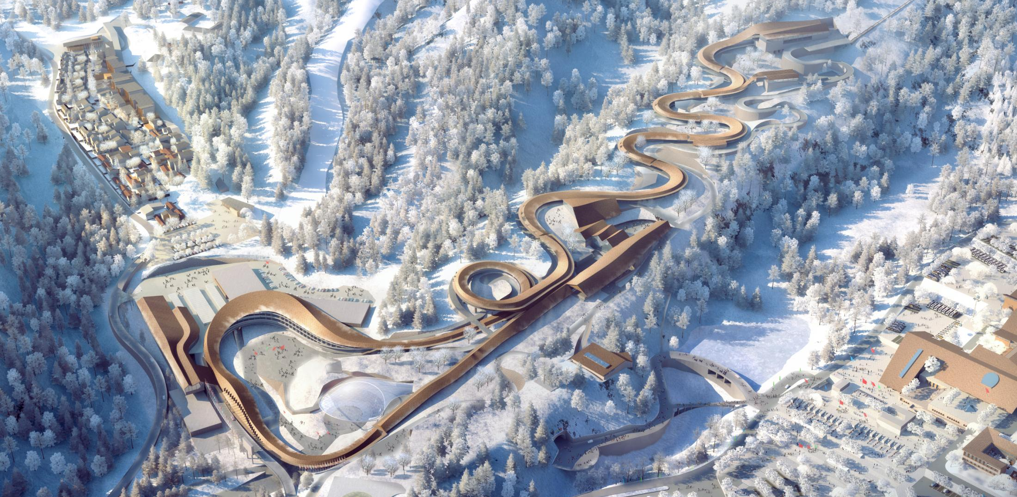
Practices of timber buildings in China
2022年冬奥会延庆赛区
Yanqing 2022 Winter Olympic Games: Yanqing National Sliding Centre
Structural System: Steel-wood hybrid structure
Type: Sports building
Location: Beijing, China
Building Area: 52,600 m²
Features: The first and only bobsleigh and luge track in China, with a total length of 1986 meters and a height difference of 121 meters, featuring 16 curves, including the only 360-degree loop in the world. The track is covered by a steel-glued laminated timber combination structure canopy

Slide 14
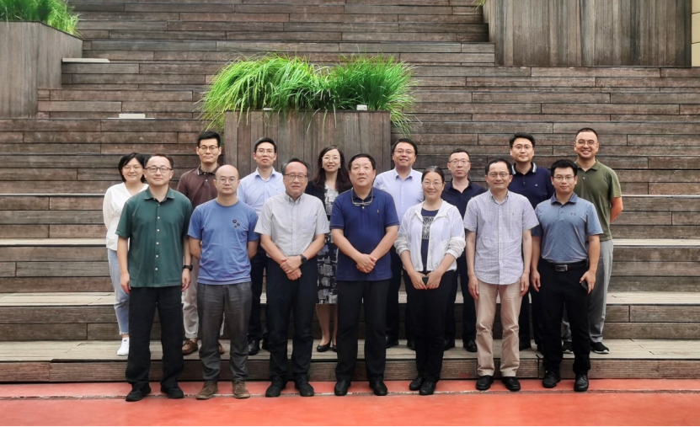
Challenges for switching to net zero emission resources
There is need to systematically enrich the application scenarios of wooden structures and explore their applications in small scenes, municipal engineering, and urban renewal
The current standards and specifications for wooden structures need to be improved, and efforts should be made to increase the proportion of bamboo and wood materials used in construction
There is a lack of scientific research, especially in the areas of fire resistance, which requires strengthening experiments and analysis
It is necessary to enhance public awareness of the application of wooden structures
Facing the challenges of material costs and dependence on imports, efforts should be made to develop local bamboo and wood materials
On 16th July 2024, the wood structure building standards seminar was held by NCTI-GB, which was initiated by Cui Kai, an academician of Chinese Academy of Engineering and the chief scientist of NCTI-GB, to discuss the challenges and solutions of promoting bamboo and wood materials

Slide 15
Part 04
Prospects

Slide 16
Prospects：Empowering transformation through innovation centers
1
functional positioning
Consolidate scientific and technological innovation resources and build an integrated innovation platform
At the international level: Promote international interconnectivity and mutual recognition, and advance international exchanges and cooperation in the green and low-carbon buildings area
3
Development
Goals
At the national level: Explore multidisciplinary, cross-field integrated innovation, and become the national strategic technological force in the green and low-carbon buildings area
At the sector level: Emphasize the support of digital technology, focus on reducing carbon emissions and increasing carbon sequestration, address key integration issues throughout the entire lifecycle of green and low-carbon buildings, and promote deep integration of the innovation chain, industry chain, financial chain, and talent chain
Electrification:
Research on the Compilation of Building Electrification Technology Catalog and the Implementation Roadmap of Typical Cities (International agency funded)
Switching to net-zero emission resources:
Research on the Current Status and Problems of Bamboo and Wood Materials in Building Applications (Industry funded)
Policy evaluation:
Research on the Current Status and Trends of Building Energy Efficiency and Green Building Development during the 14th Five Year Plan Period (Government funded)
…
N
Research Projects
8
Key Tasks
Technology
research
Demonstration
project
Standard &
regulation
Experimental
testing
Technology
conversion
High-end
think tank
Talent
development
international
cooperation
NCTI-GB’s strategy and ongoing research projects to drive electrification and switching to net-zero emission resources in China

Slide 17

Thank you for you attention
Dr. Hua Wang
Senior Researcher
National Center of Technology Innovation for Green and Low-Carbon Building, China
No.36 Deshengmenwai Street, Xicheng District, Beijing 100088
Email：wanghua0704@126.com

